Slide 1
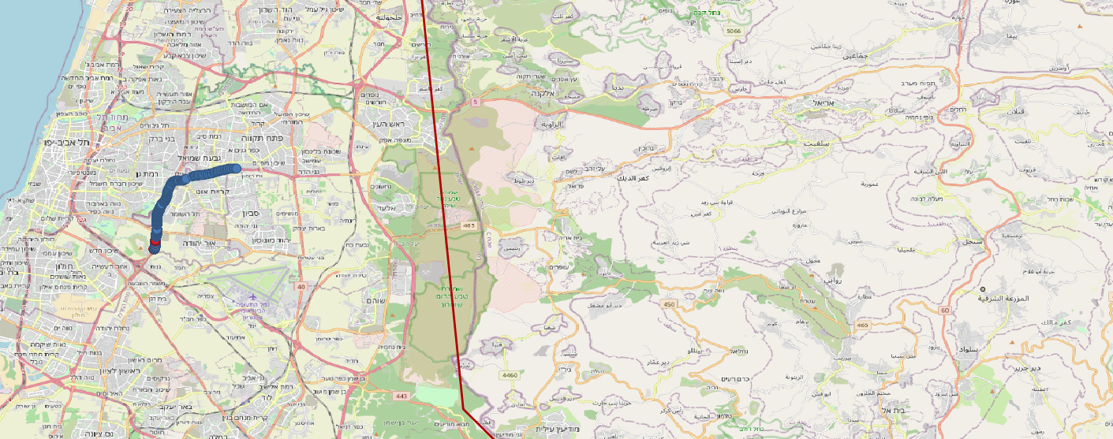
Analysis Site 29228 / Distance from the border (threshold92- )
For this example, we take only the dots on site 29228.
Calculate the statistics from the DT to the green border.
10.7 – 15 km

Slide 2
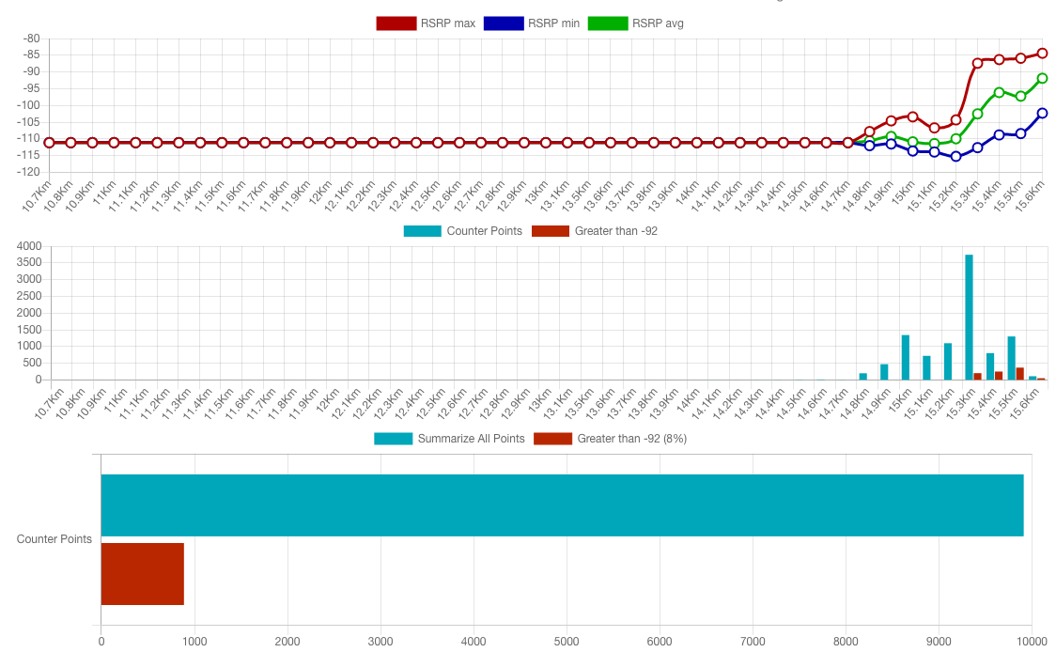
Analysis Site 29228 / Distance from the border (threshold92- )
Distances we saw in the previous slide
Distances we saw in the previous slide
Blue dots on the map
Red dots on the map

Slide 3
Analysis Site 29228 / Distance from the border (threshold92- )
Calculate the statistics from the DT to the site.
40 – 44 km

Slide 4
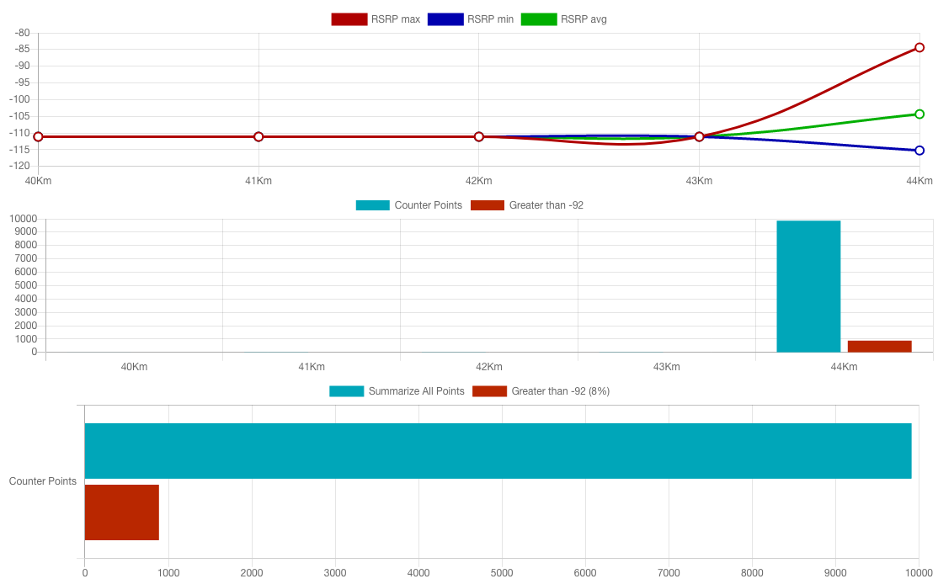
Analysis Site 29228 / Distance from the site (threshold92- )
Distances we saw in the previous slide
Distances we saw in the previous slide
Blue dots on the map
Red dots on the map

